Slide 1
Improving Diffusion Model Sampling Speed, Generalization of Diffusion on Riemannian Manifolds, and Applications to Biometrics
Luke Chen
B.S. UC Berkeley Mathematics + Computer Science
Masters Student | KAIST Mathematical Sciences | Professor Wooseok Ha Lab (WHA Lab)

Slide 2
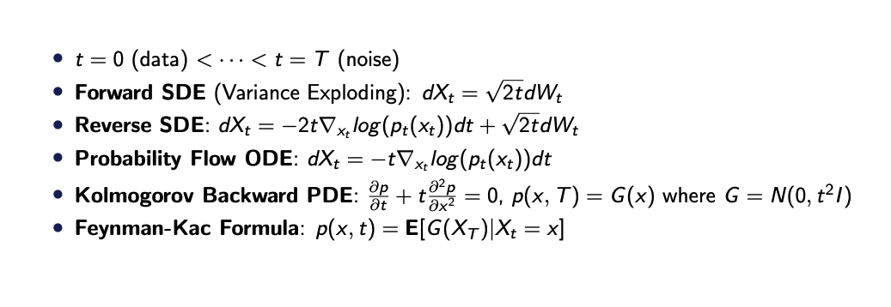
Problem Setting
t = 0 (data) < · · · < t = T (noise)
√
Forward SDE (Variance Exploding): dX_{t} = 2tdW_{t}
Reverse SDE: dX_{t} = −2t∇_{xt} log (p_{t} (x_{t} ))dt + √2tdW_{t}
Probability Flow ODE: dX_{t} = −t∇_{xt} log (p_{t} (x_{t} ))dt
2
•
∂p ∂ p
2
Kolmogorov Backward PDE: + t = 0, p(x, T ) = G (x ) where G = N(0, t I )
∂t ∂x ²
Feynman-Kac Formula: p(x, t) = E[G (X_{T} )|X_{t} = x ]

Slide 3
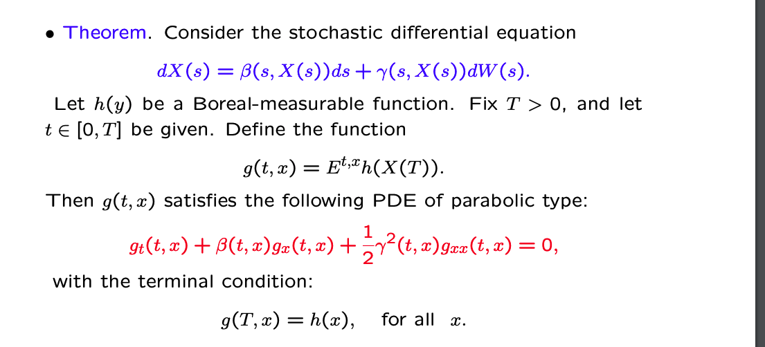
Feymann-Kac Formula

Slide 4
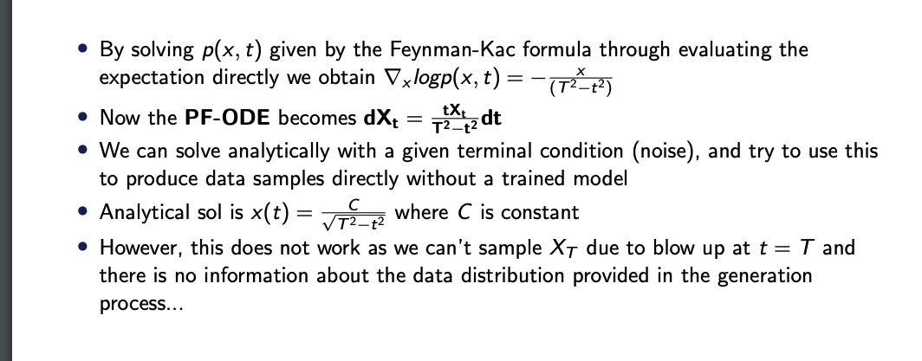
Setting (continued)
By solving p(x, t) given by the Feynman-Kac formula through evaluating the
expectation directly we obtain ∇_{x} logp(x, t) = −
tX
x
2
(T ²−t )
Now the PF-ODE becomes dX = dt
t
t
T²−t²
We can solve analytically with a given terminal condition (noise), and try to use this to produce data samples directly without a trained model
Analytical sol is x (t) = ^{√ C} where C is constant
T ²−t²
However, this does not work as we can’t sample X_{T} due to blow up at t = T and there is no information about the data distribution provided in the generation process...

Slide 5
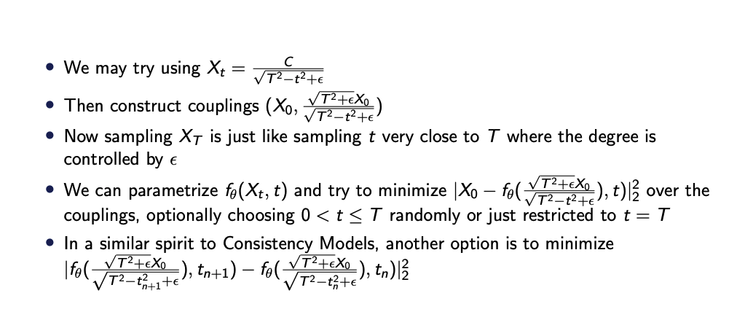
Setting (continued)
We may try using X_{t} = √
C
T ²−t²+ϵ
√T ²+ϵX0
Then construct couplings (X₀, √_{T 2−t2+ϵ} )
Now sampling X_{T} is just like sampling t very close to T where the degree is controlled by ϵ
•
We can parametrize f_{θ} (X_{t}, t) and try to minimize |X₀ − f_{θ} (
√T ²+ϵX0
2
√
), t)| over the
2 2
2
T −t +ϵ
couplings, optionally choosing 0 < t ≤ T randomly or just restricted to t = T
In a similar spirit to Consistency Models, another option is to minimize
√T ²+ϵX0
√T ²+ϵX0
√
√
2
2
), t )|
|f (
), t ) − f (
n
θ
2 2
n+1 θ
T −t +ϵ
2 2
T −t +ϵ
n+1
n

Slide 6
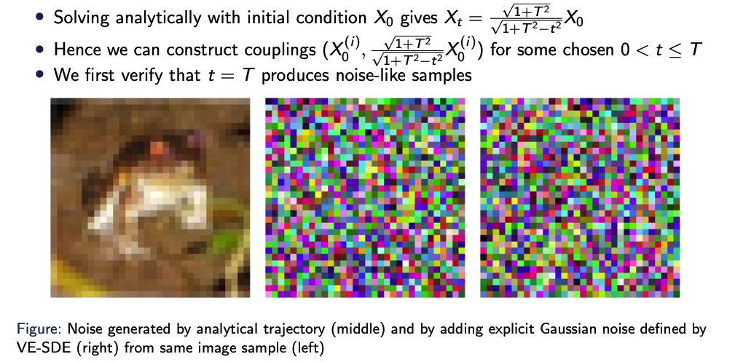
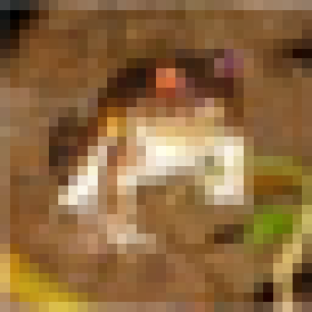

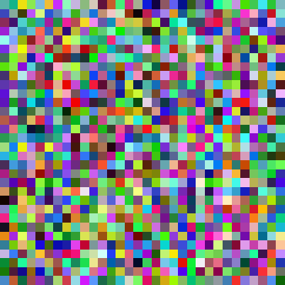
Experiments
√1+T ²
Solving analytically with initial condition X₀ gives X_{t} = √_{1+T 2−t2} X₀
(i ) (i )
Hence we can construct couplings (X₀
√1+T ²
) for some chosen 0 < t ≤ T
, √1+T ²−t^{2 X0}
We first verify that t = T produces noise-like samples
Figure: Noise generated by analytical trajectory (middle) and by adding explicit Gaussian noise defined by VE-SDE (right) from same image sample (left)

Slide 7
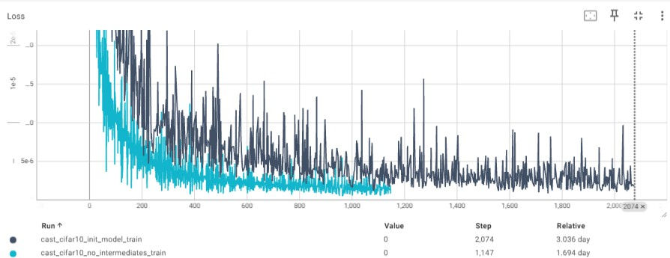
Experiments (continued)
Now we train a neural net model to match these couplings
(1) Try with randomly selected intermediate t values
(2) Try only with t = T
Figure: Loss progression of (1) in black and (2) in blue
6 / 8

Slide 8

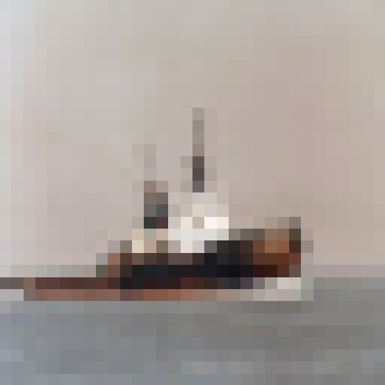
Experiments (continued)
(1) Results are poor when model uses randomly sampled noise as input for generation
(2) Results are solid (FID-wise) when model uses ’noise’ samples created from images via the analytical trajectory (it performs near-perfect reconstruction, i.e. overfitting to dataset)
Figure: Image generated by (1) on the left and (2) on the right

Slide 9
Next Steps
(1) Try training with an additional 1M+ images generated by EDM, same as how CAF trained, to alleviate overfitting
(2) Try using a different loss function (currently loss is MSE between image and network output) or add sub-losses such as GAN
(3) Try using a different loss formulation?
Additionally, could change model architecture (currently using CAF’s velocity network architecture - although it is highly unlikely changing this will yield significant improvements..)

Slide 10
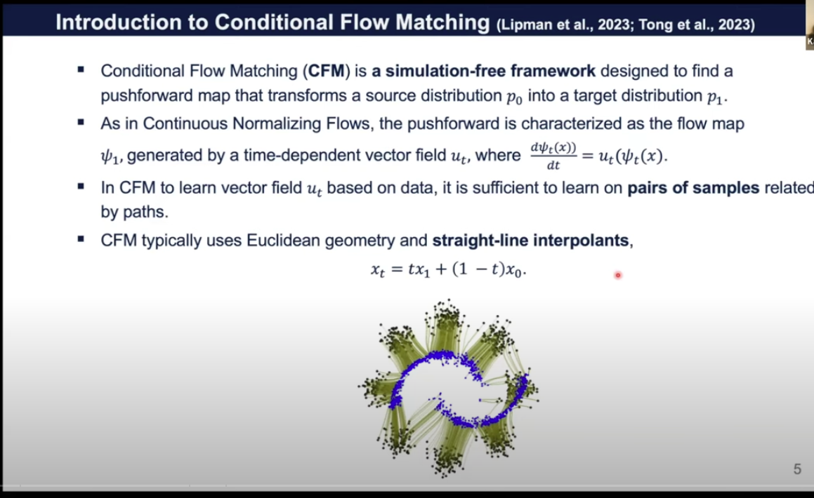
Conditional Flow Matching / Rectified Flows (Euclidean Space)

Slide 11
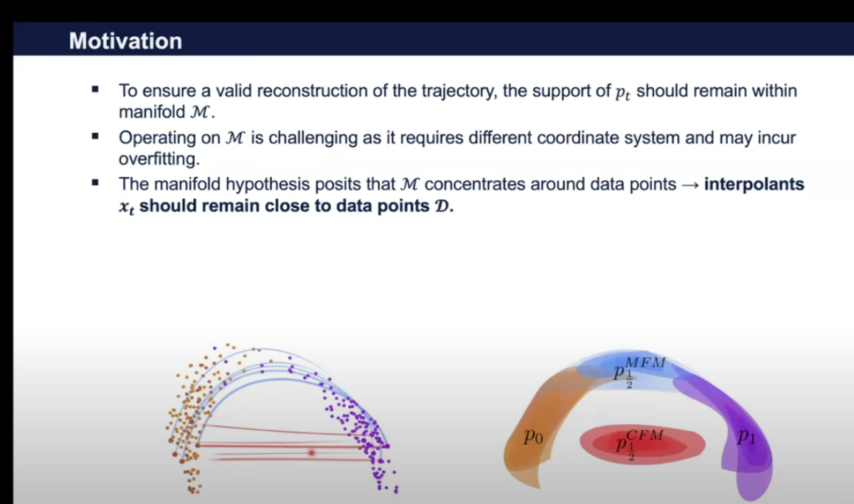
Manifold Hypothesis

Slide 12
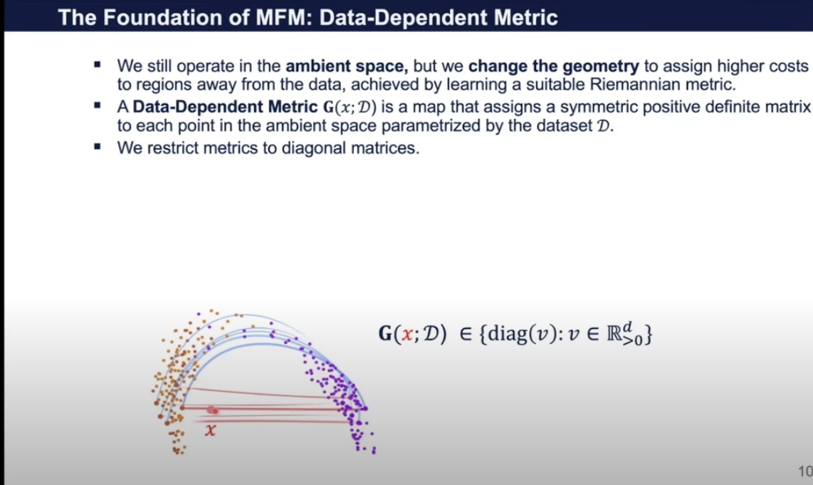
Metric Flow Matching

Slide 13
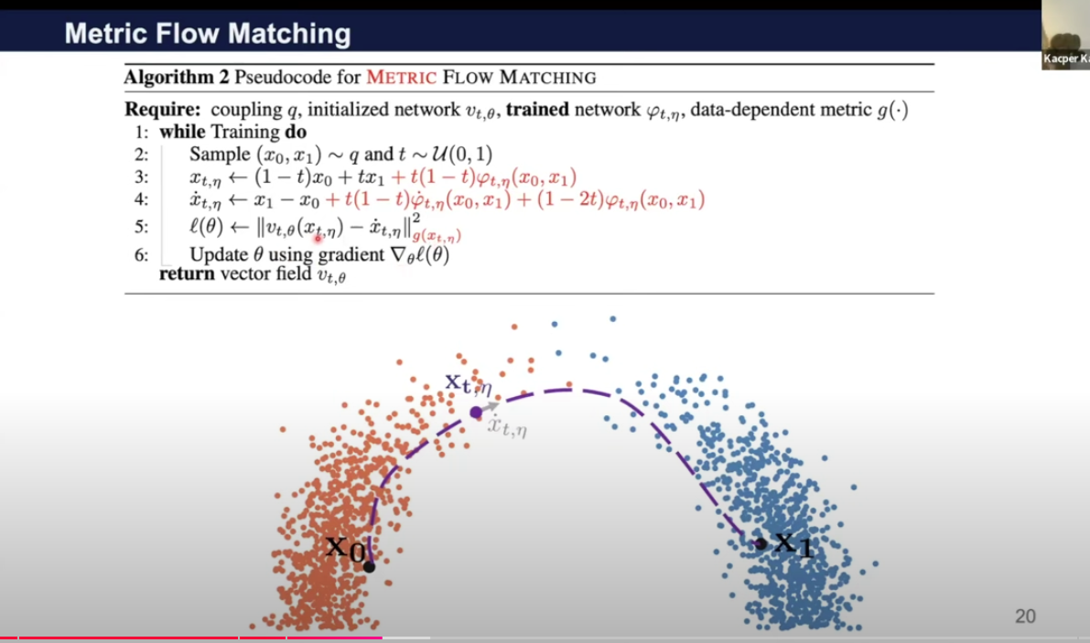

Slide 14
Future Research Direction
Treat Probability Density of Iris Image Sample (or Face Image Sample) as a Riemannian Manifold
Apply the Metric Flow Matching algorithm with potential modification

Slide 15
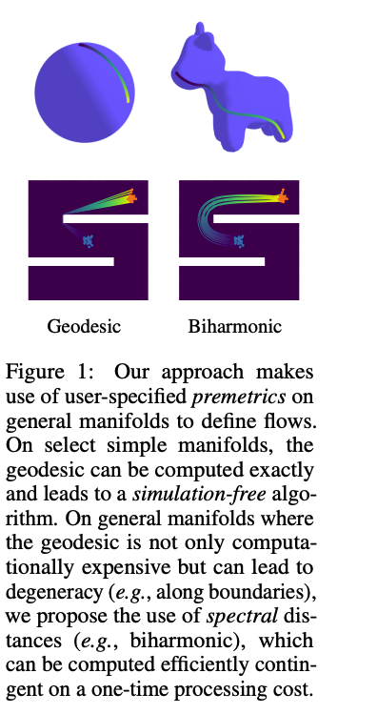
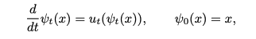
Riemannian Flow Matching (Ricky T.Q. Chen, Yaron Lipman)
Simple yet powerful methodology for learning continuous normalizing flows on a general Riemannian manifold M Time Dependent Flow on M is defined by solving the following ODE over t ∈ [0, 1]
(Chen et al., 2018)

Slide 16
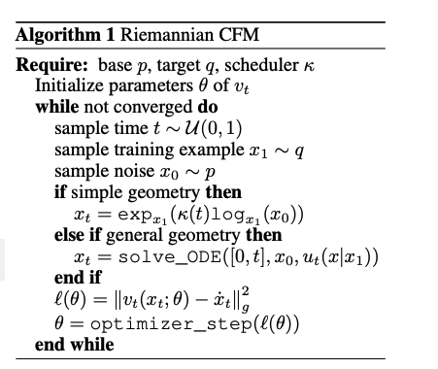
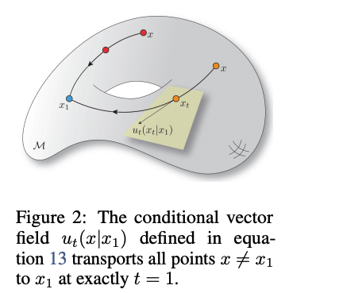
Riemannian Flow Matching Algorithm (Typical ODE Solver = dopri15)
(Chen et al., 2018)

Slide 17
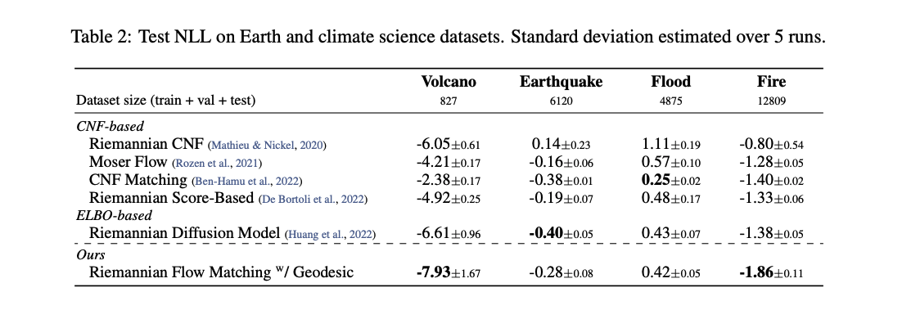
Riemannian Flow Matching on Earth & Climate Science Datasets
(Chen et al., 2018)

Slide 18
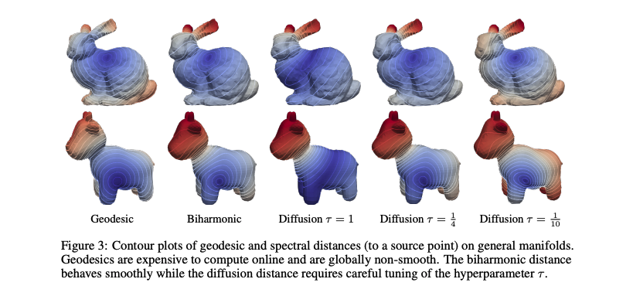
Riemannian Flow Matching Experimental Results
(Chen et al., 2018)

Slide 19
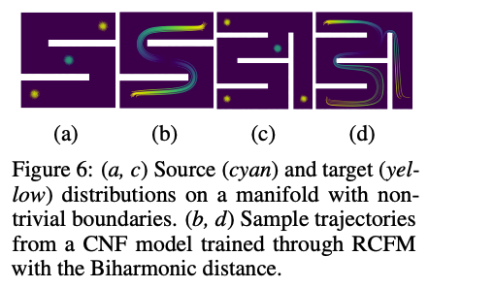
Riemannian Flow Matching Results: Biharmonic Distance
(Chen et al., 2018)

Slide 20
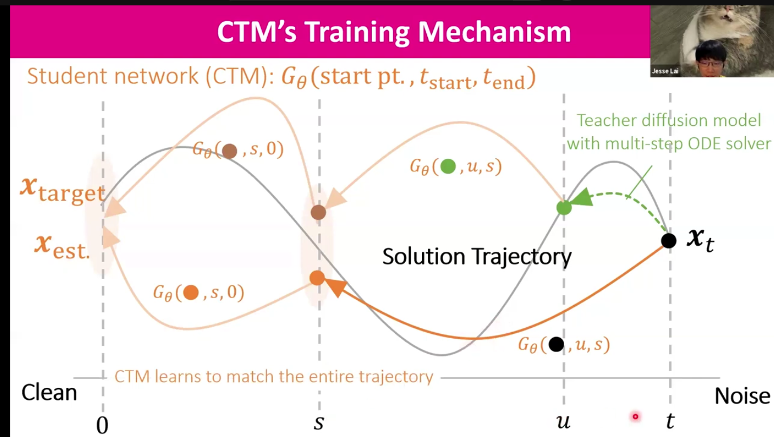
Consistency Trajectory Models 1 Step SOTA Image Generation Quality in Euclidean Space

Slide 21
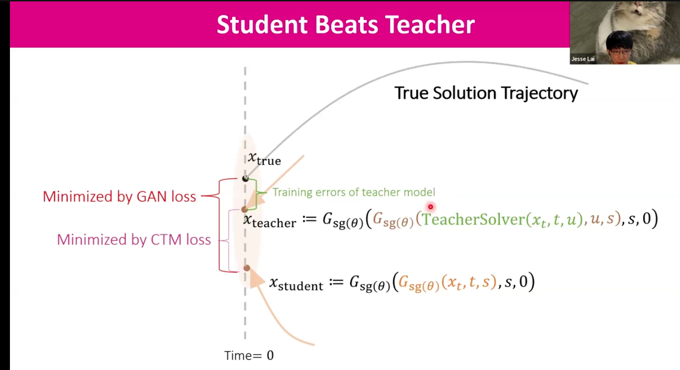
Consistency Trajectory Models (Continued)

Slide 22
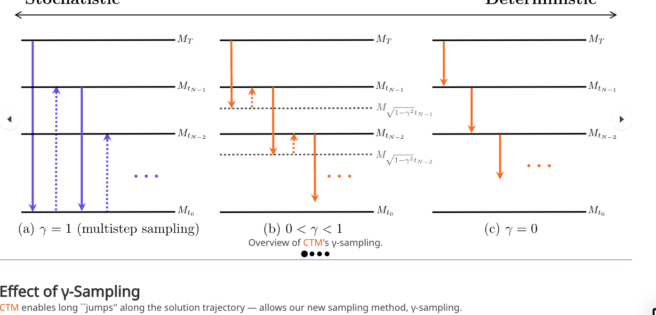
Consistency Trajectory Models: Gamma (Hybrid Sampling)

Slide 23
Future Research Direction #2
Treat the probability density of Iris Images or Face Images as a Riemannian Manifold
Apply Riemannian Flow Matching (Generally SOTA for Riemannian Generative Models for Stanford Bunny, Spot the Cow, Earth/Climate Science datasets) with a slight modification to improve the suitability for iris images
Potential Problem: Training Time / GPU Resource Tradeoff
Possible Improvement: Can the Consistency Trajectory Model be extended to distill the probability flow diffusion ODE path on a Riemannian Manifold in 1 Step?
Would be much faster than using the dopri15 numerical ODE solver, as in RFM
Test on common diffusion image datasets that are not iris images

Slide 24
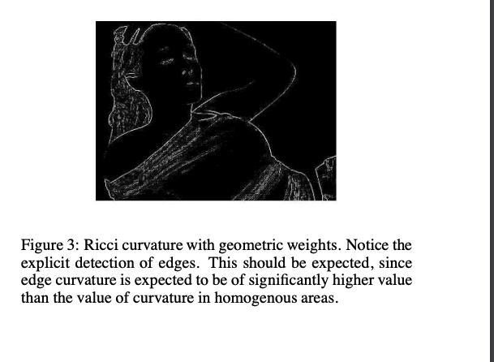
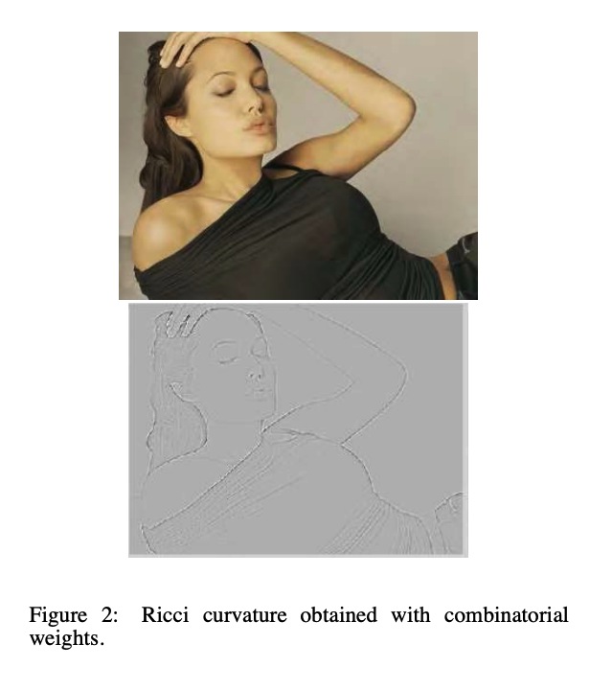
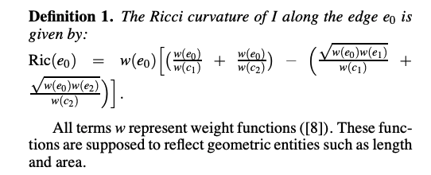
Ricci Curvature by Treating Images as Riemannian Manifolds

Slide 25
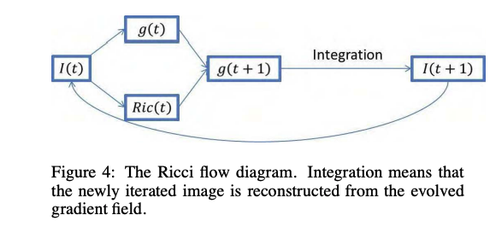
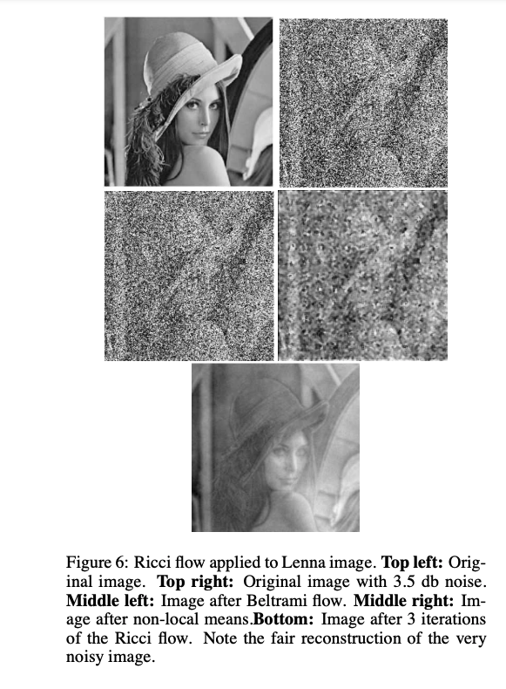
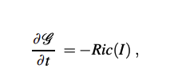
Ricci Flow for Image Denoising Task
G is the image metric and Ric denotes the Ricci curvature

Slide 26
Future Research Direction #3
Treat the Iris Image itself as a Riemannian Manifold
Observe the Ricci Curvature for Edge Detection
If it looks good, then we can test Ricci Flow for Denoising an Iris Image (Same as Generation)

Slide 27
Potential Impact on Biometrics
Generating synthetic iris or face images can be used for…
1) “Anti-Spoofing”
2) Increased security of iris biometric or face biometric systems!
Question: How important is sampling speed for generating synthetic iris or face images? (Typically number of NFEs matters for diffusion for image/video generation)

Slide 28
Acknowledgements
Big thanks to my collaborator Soohan Kim
And to my Masters advisors Professor Wooseok Ha and Professor Youngjoon Hong

